Slide 1
Emerging Technologies for the Circular Economy
Lecture 8: Introduction to Blockchain Technology
Prof. Dr. Benjamin Leiding
M.Sc. Anant Sujatanagarjuna
M.Sc. Shohreh Kia

Slide 2
License
This work is licensed under a Creative Commons Attribution-ShareAlike 4.0 International License. To view a copy of this license, please refer to https://creativecommons.org/licenses/by-sa/4.0/ .
Updated versions of these slides will be available in our Github repository.

Slide 3
Disclaimer and Further Resources
The lecture slides are based on the course “Blockchain-based Systems Engineering” from TU Munich
All their slides, exercises and further information are available online – Link→ We stipulate that all M2X-related interactions, transactions, collaborations, and further enactments can be governed and represented using a blockchain-based smart contract.
U. Gallersdörfer, P. Holl, and F. Matthes, “Blockchain-based Systems Engineering – Lecture Slides,” Oct 2019. [Online]. Available: https://github.com/sebischair/bbse

Slide 4
News/Updates

Slide 5

Course Evaluation – QR Code and Link
For the course: „Emerging Technolgoies for the Circular Economy”
Link: Click Me

Slide 6

Course Evaluation – QR Code and Link
For the course: „IoT and Digitalization for Circular Economy”
Link: Click Me

Slide 7
Introduction and History

Slide 8
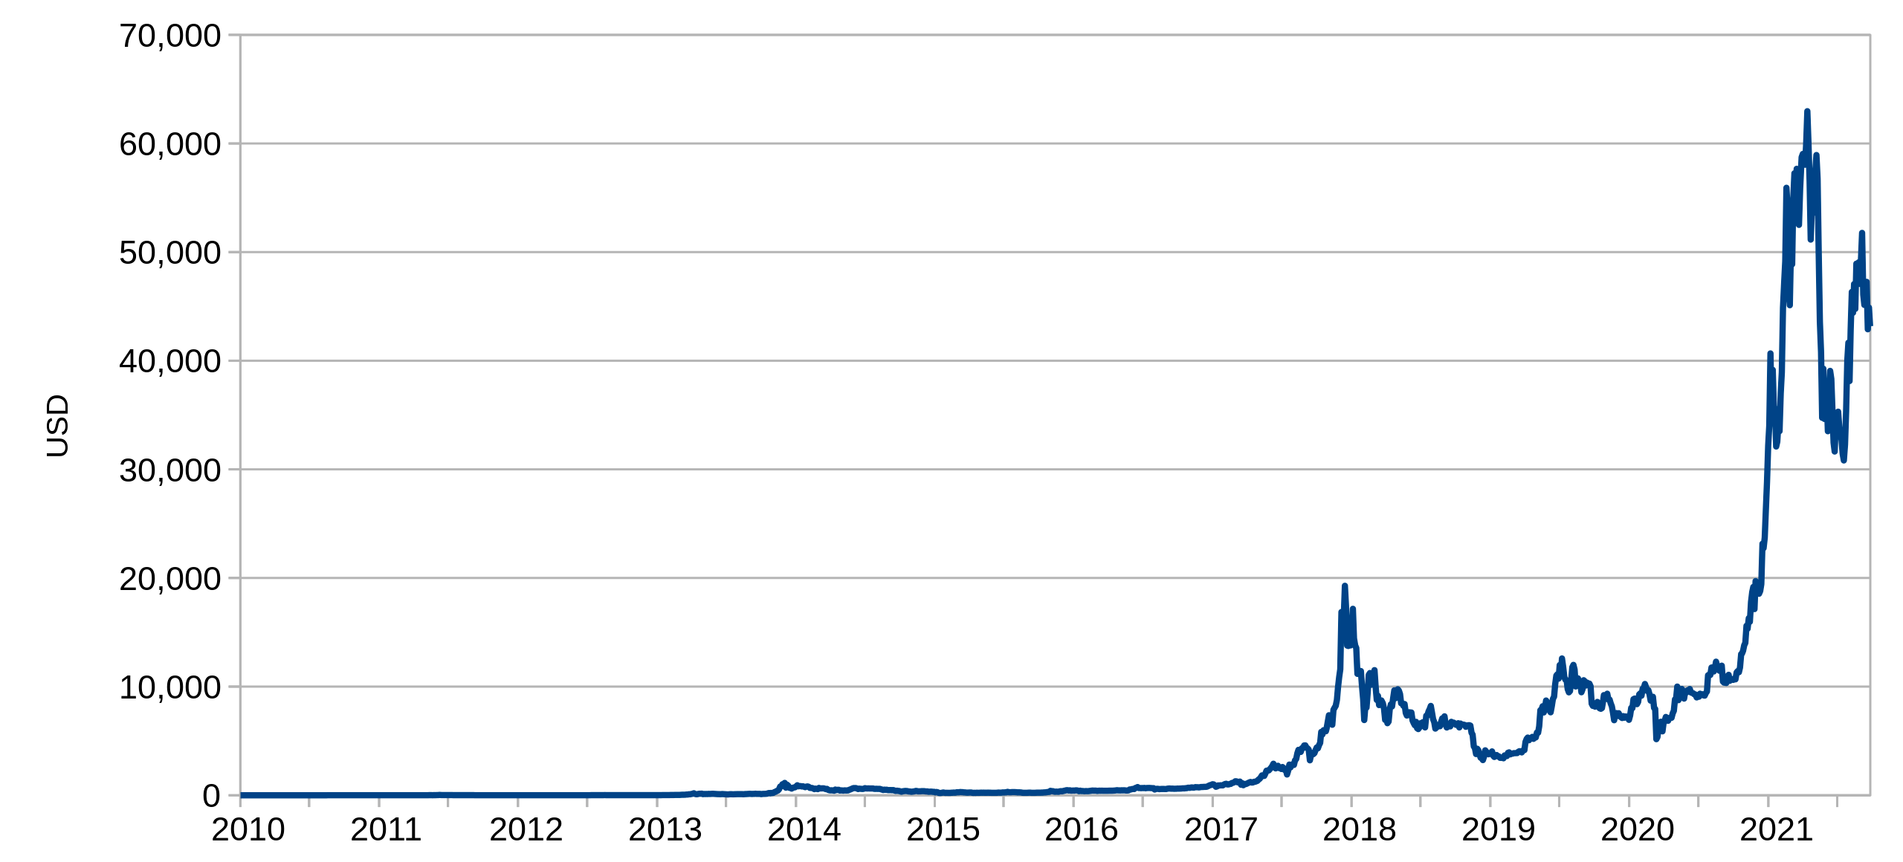
History
Line chart of Bitcoin price to US dollars, by FrankAndProust licensed under CC0 1.0 Universal Public Domain

Slide 9
History
Bitcoin: A Peer-to-Peer Electronic Cash System
Satoshi Nakamoto
satoshin@gmx.com
www.bitcoin.org
Abstract. A purely peer-to-peer version of electronic cash would allow online payments to be sent directly from one party to another without going through a financial institution. Digital signatures provide part of the solution, but the main benefits are lost if a trusted third party is still required to prevent double-spending. We propose a solution to the double-spending problem using a peer-to-peer network. The network timestamps transactions by hashing them into an ongoing chain of hash-based proof-of-work, forming a record that cannot be changed without redoing the proof-of work. The longest chain not only serves as proof of the sequence of events witnessed, but proof that it came from the largest pool of CPU power. As long as a majority of CPU power is controlled by nodes that are not cooperating to attack the network, they'll generate the longest chain and outpace attackers. The network itself requires minimal structure. Messages are broadcast on a best effort basis, and nodes can leave and rejoin the network at will, accepting the longest proof-of-work chain as proof of what happened while they were gone.
S. Nakamoto, “Bitcoin: A Peer-to-Peer Electronic Cash System,” https://bitcoin.org/bitcoin.pdf

Slide 10
Blockchain Essentials
Bitcoin ≠ Blockchain
Blockchain is the fundamental technology
Bitcoin is a specific implementation

Slide 11
Blockchain Essentials
Bitcoin ≠ Blockchain
What makes Bitcoin special?
Decentralized digital currency → No central bank, no government
No (trusted) third-party required to validate transaction in contrast to banks, Paypal, Western Union, etc.
Bitcoins can be transferred but not duplicated
Transparent
Pseudonymous, not anonymous!
Deflationary (max. 21 million coins)

Slide 12
Blockchain Essentials
Bitcoin ≠ Blockchain
What makes Bitcoin special?
Decentralized digital currency → No central bank, no government
No (trusted) third-party required to validate transaction in contrast to banks, Paypal, Western Union, etc.
Bitcoins can be transferred but not duplicated
Transparent
Pseudonymous, not anonymous!
Deflationary (max. 21 million coins)

Slide 13
Blockchain Technology

Slide 14
Overview
Underlying concepts are not revolutionary, all of them have already been used for years, BUT mixing them all together was a revolutionary step.
In essence, blockchain is a:
distributed,
secure,
logfile.

Slide 15
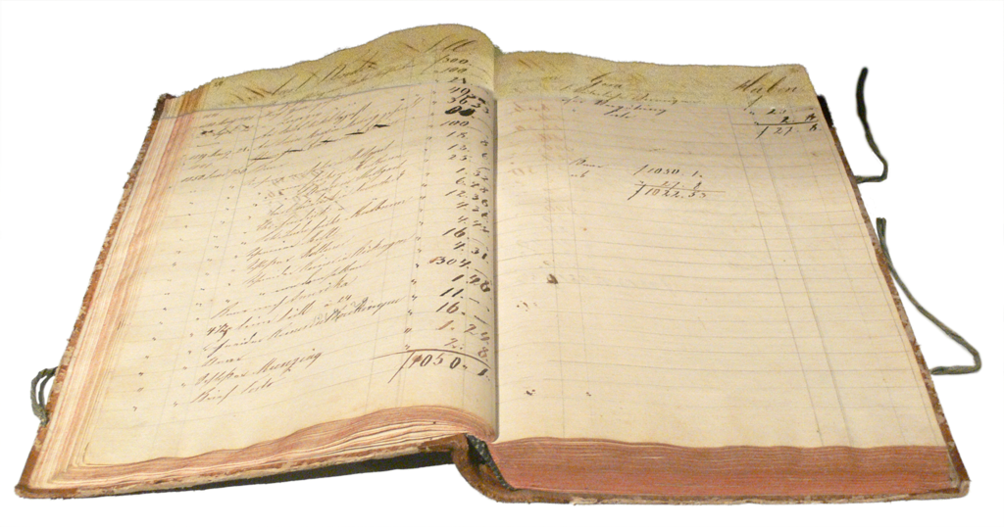
Transaction Ledger
Essentially a list of transactions
e.g., Listing money going in/out
But can also be used for other things, such as maintaining a record of all changes made to a house, all the owners, etc, or an “auto scheckheft”
A german ledger from 1828, by RaphaelQS licensed under CC0 1.0 Universal Public Domain

Slide 16
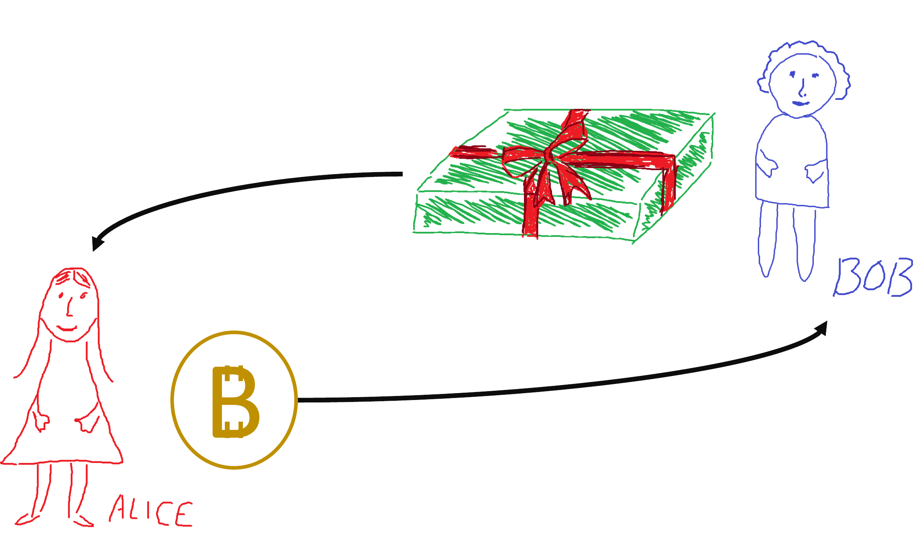
Transactions

Slide 17
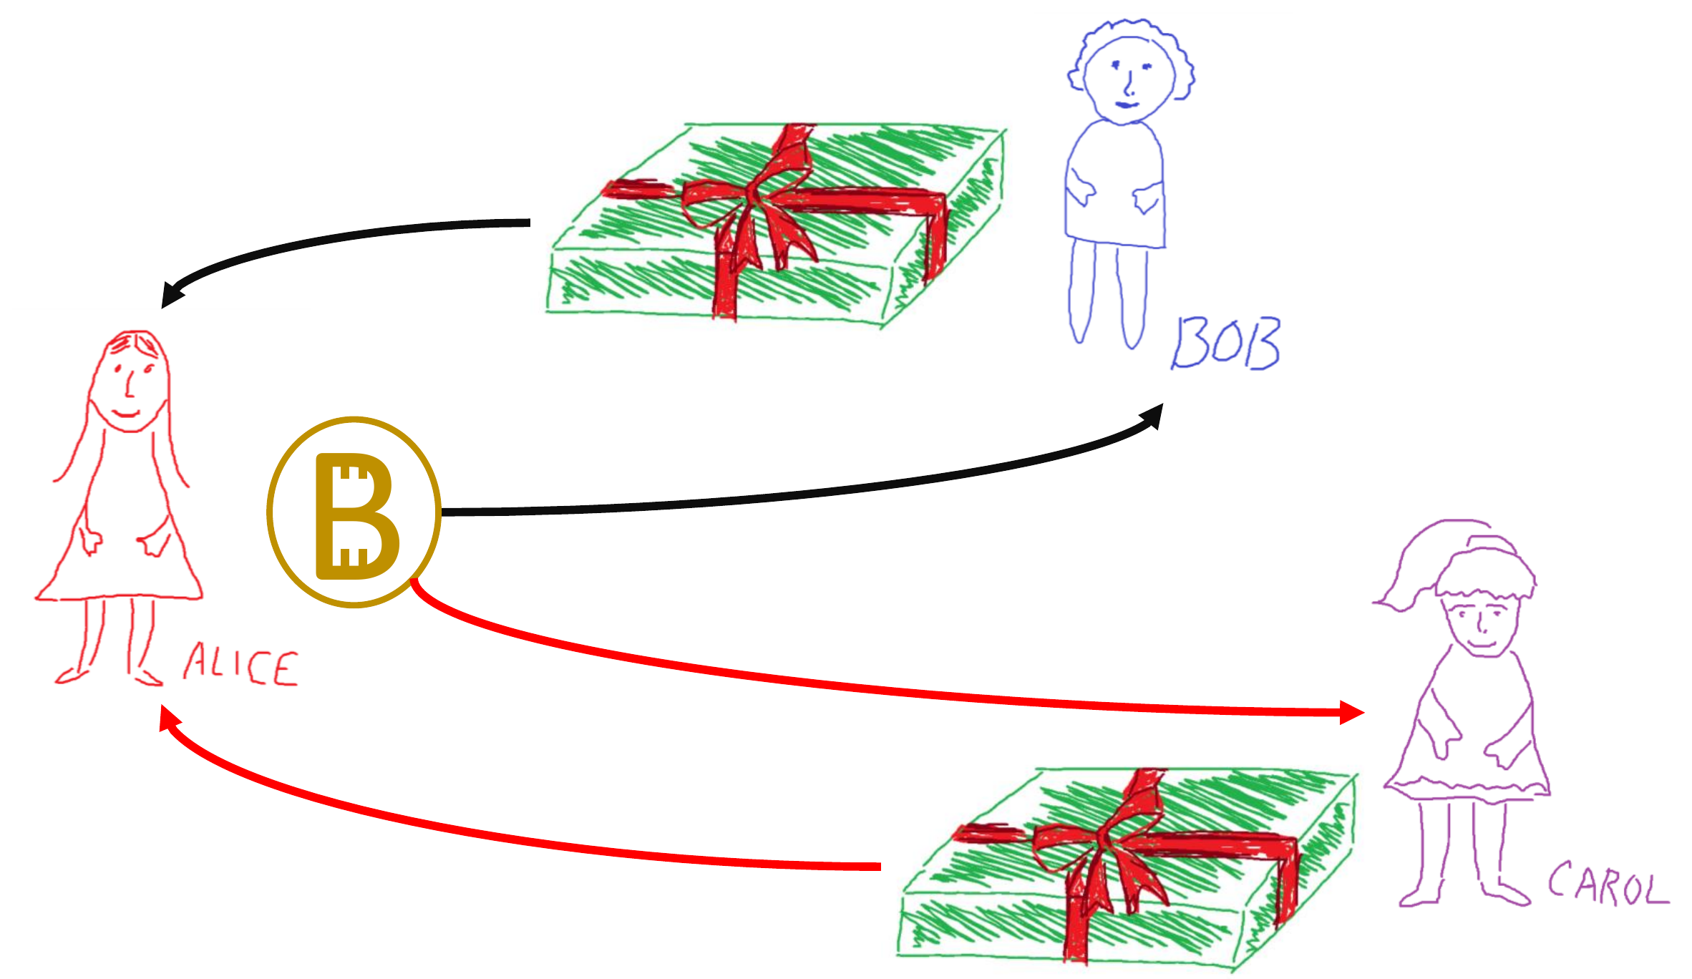
Double Spending Problem

Slide 18
Double Spending Problem
The most common solution to the double spending problem:
Banks and other intermediaries (Amazon, Ebay) → adds significant cost
Main problem → trust in intermediaries:
The intermediary can tamper with the data
Difficult to do on a global scale while maintaining trust, accountability and transparency

Slide 19
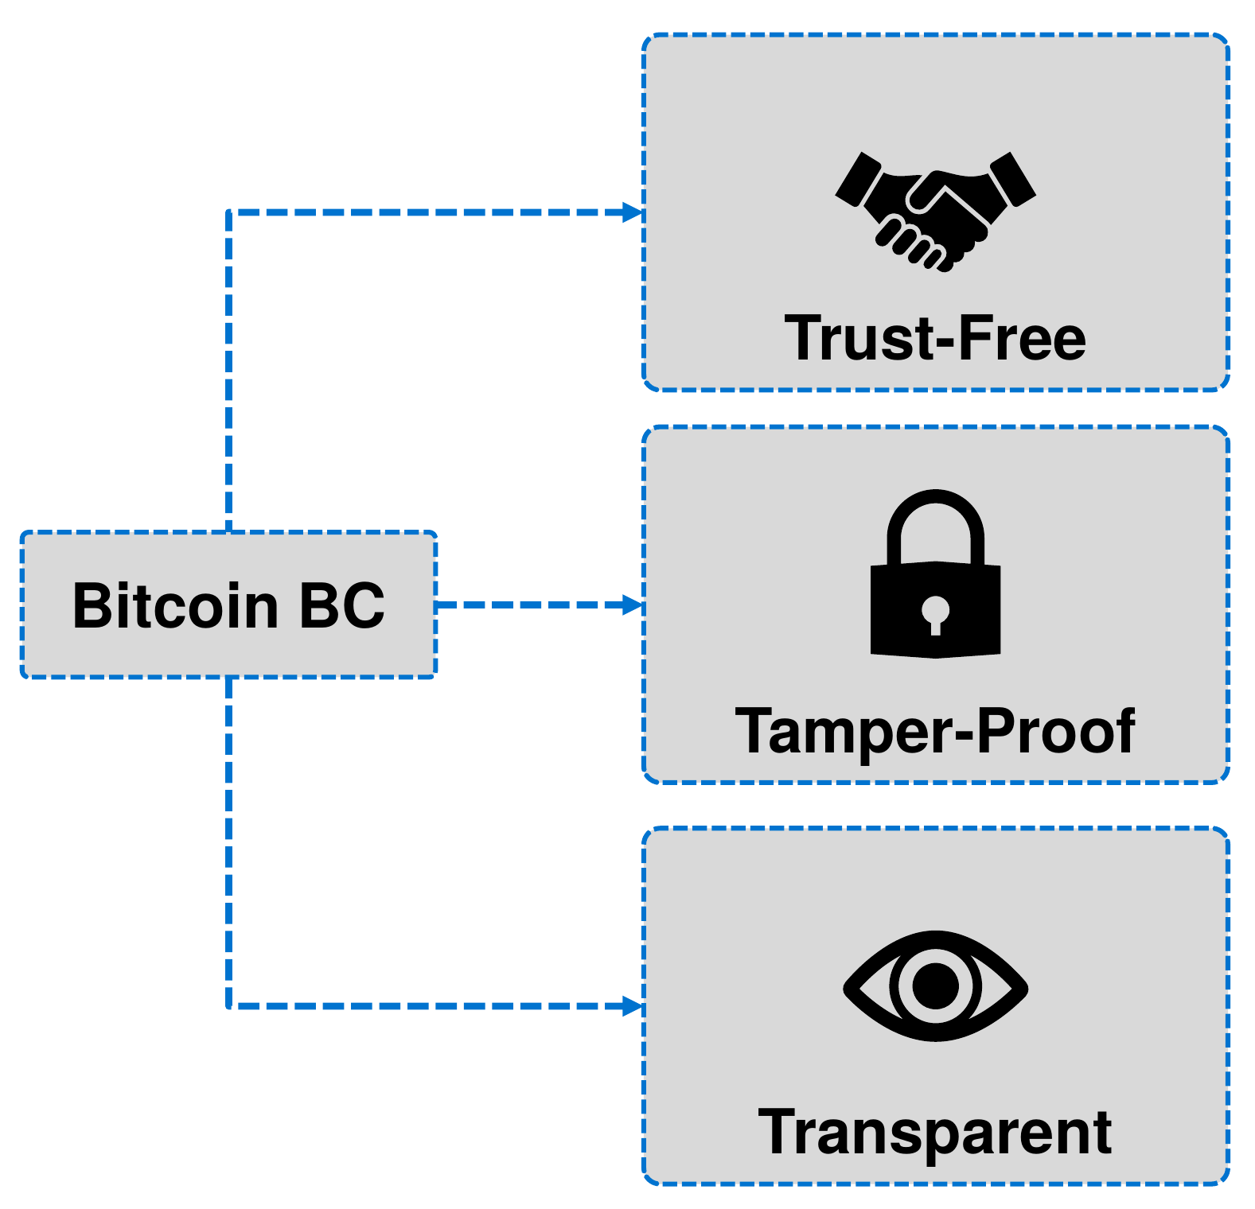
Key Properties
Trust-Free: The system does not require a third party which controls or maintains the system.
Tamper-Proof: The system is resistant to manipulation. The history of events cannot be changed.
Transparent: Every participant of the system can read and validate all information and the current state.
U. Gallersdörfer, P. Holl, and F. Matthes, “Blockchain-based Systems Engineering – Lecture Slides,” Oct 2019. [Online]. Available: https://github.com/sebischair/bbse

Slide 20
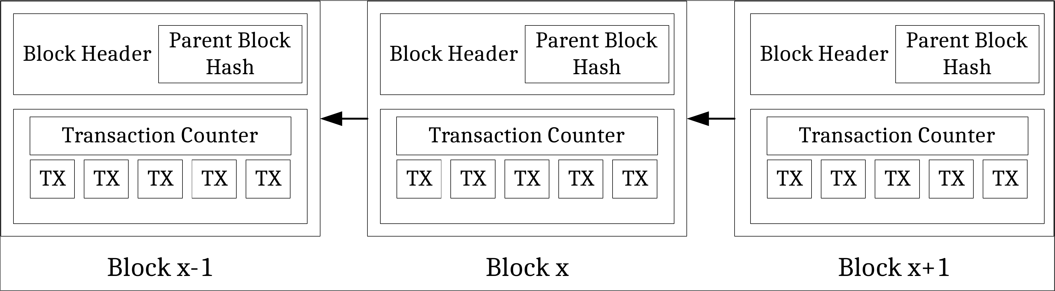
Blockchain
Append-only sequential data structure (list)
New blocks can only be added to the end of the chain
Chaining blocks together → blockchain
Changing a block requires recalculation of all subsequent blocks
Massively duplicated (redundant) across the network (P2P)
⇒ How to reach consensus on which transactions are part of the next block?

Slide 21
Blockchain
Append-only sequential data structure (list)
New blocks can only be added to the end of the chain
Chaining blocks together → blockchain
Changing a block requires recalculation of all subsequent blocks
Massively duplicated (redundant) across the network (P2P)
⇒ How to reach consensus on which transactions are part of the next block?

Slide 22
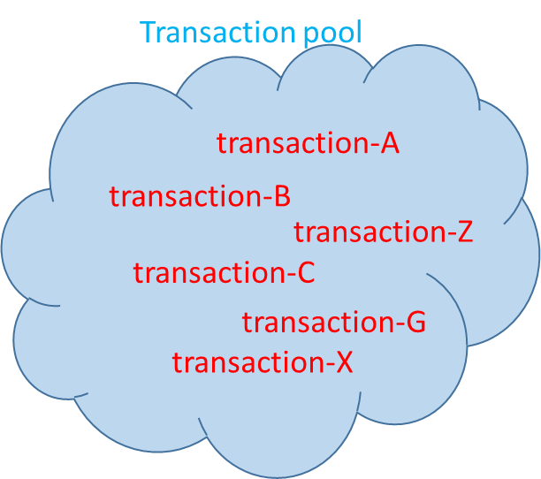
Consensus
1
Block 100
5
Block 100
7
Block 100
8
Block 100
3
Block 100
6
Block 100
2
Block 100
4
Block 101

Slide 23
Consensus
1
Block 101
5
Block 101
7
Block 101
8
Block 101
3
Block 101
6
Block 101
2
Block 101
4
Block 101

Slide 24
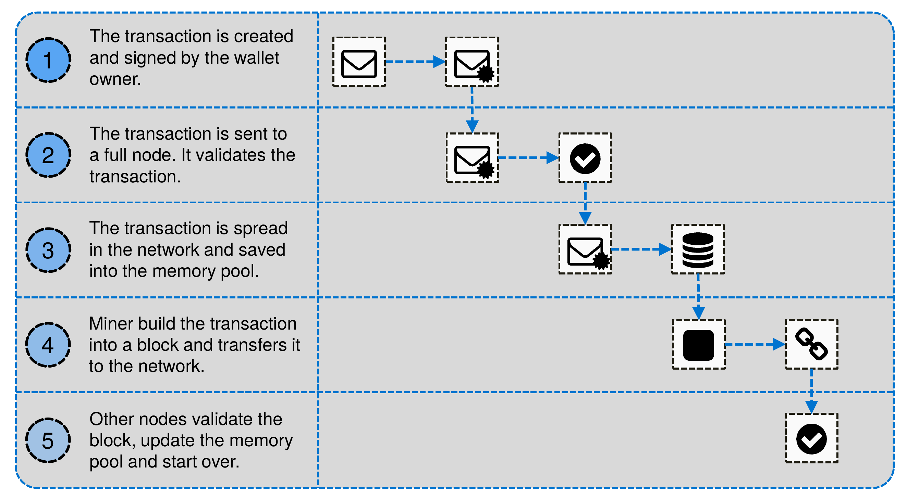
Propagating a Transaction
U. Gallersdörfer, P. Holl, and F. Matthes, “Blockchain-based Systems Engineering – Lecture Slides,” Oct 2019. [Online]. Available: https://github.com/sebischair/bbse

Slide 25
Blockchain Platforms
 | Ethereum | Hyperledger Fabric | Ripple
Industry | Cross-industry | Cross-industry | Finance
Ledger Type | Public | Permissioned | Permissioned
Currency | Ether (ETH) | - | Ripple (XRP)
Concensus | Proof-of-Work (soon Proof-of-Stake) | Different modules | Federated Byzantine Agreement
Smart Contracts | Yes | Yes | No

Slide 26
Smart Contracts
Bitcoin has a very limited scripting languages to manage transactions → Smart-contracts are far more powerful
Turing complete languages (e.g., Solidity)
Contract:
Contract code compiled to byte code - e.g., for the Ethereum virtual machine (EVM)
Code execution (may) consumes cryptocurrency (tokens)
Autonomous execution
Every node runs every contract (deterministic)
Contracts can interact with world using so called ”oracles”
Smart contract capable blockchains → Ethereum,
Corda, Qtum, etc.

Slide 27
Applications

Slide 28



Machine-to-Everything (M2X) Economy
Machine-to-Human (M2H)
+
Machine-to-Machine (M2M)
+
Machine-to-Infrastructure (M2I)
=
Machine-to-Everything (M2X)
<number>

Slide 29
Blockchain-based Crowdfunding
ICO = IPO on the blockchain.
Fund development of your blockchain-based idea → Collect funding in exchange for tokens
Product, team, marketing, social media, whitepaper, roadshow, etc.

Slide 30
Blockchain-based Crowdfunding
$28,366,035,804 raised between January 2014 and August 2018.
Some of the largest ICOs (in terms of how much they raised)
Coin | Total Funds raised | Year
EOS | $4.2 Billion | 2018
Telegram | $1.7 Billion | February 2018
TaTaTu | $575 Million | June 2018
Dragon Coin | $420 Million | March 2018
Based on data sourced from: https://elementus.io/token-sales-history

Slide 31
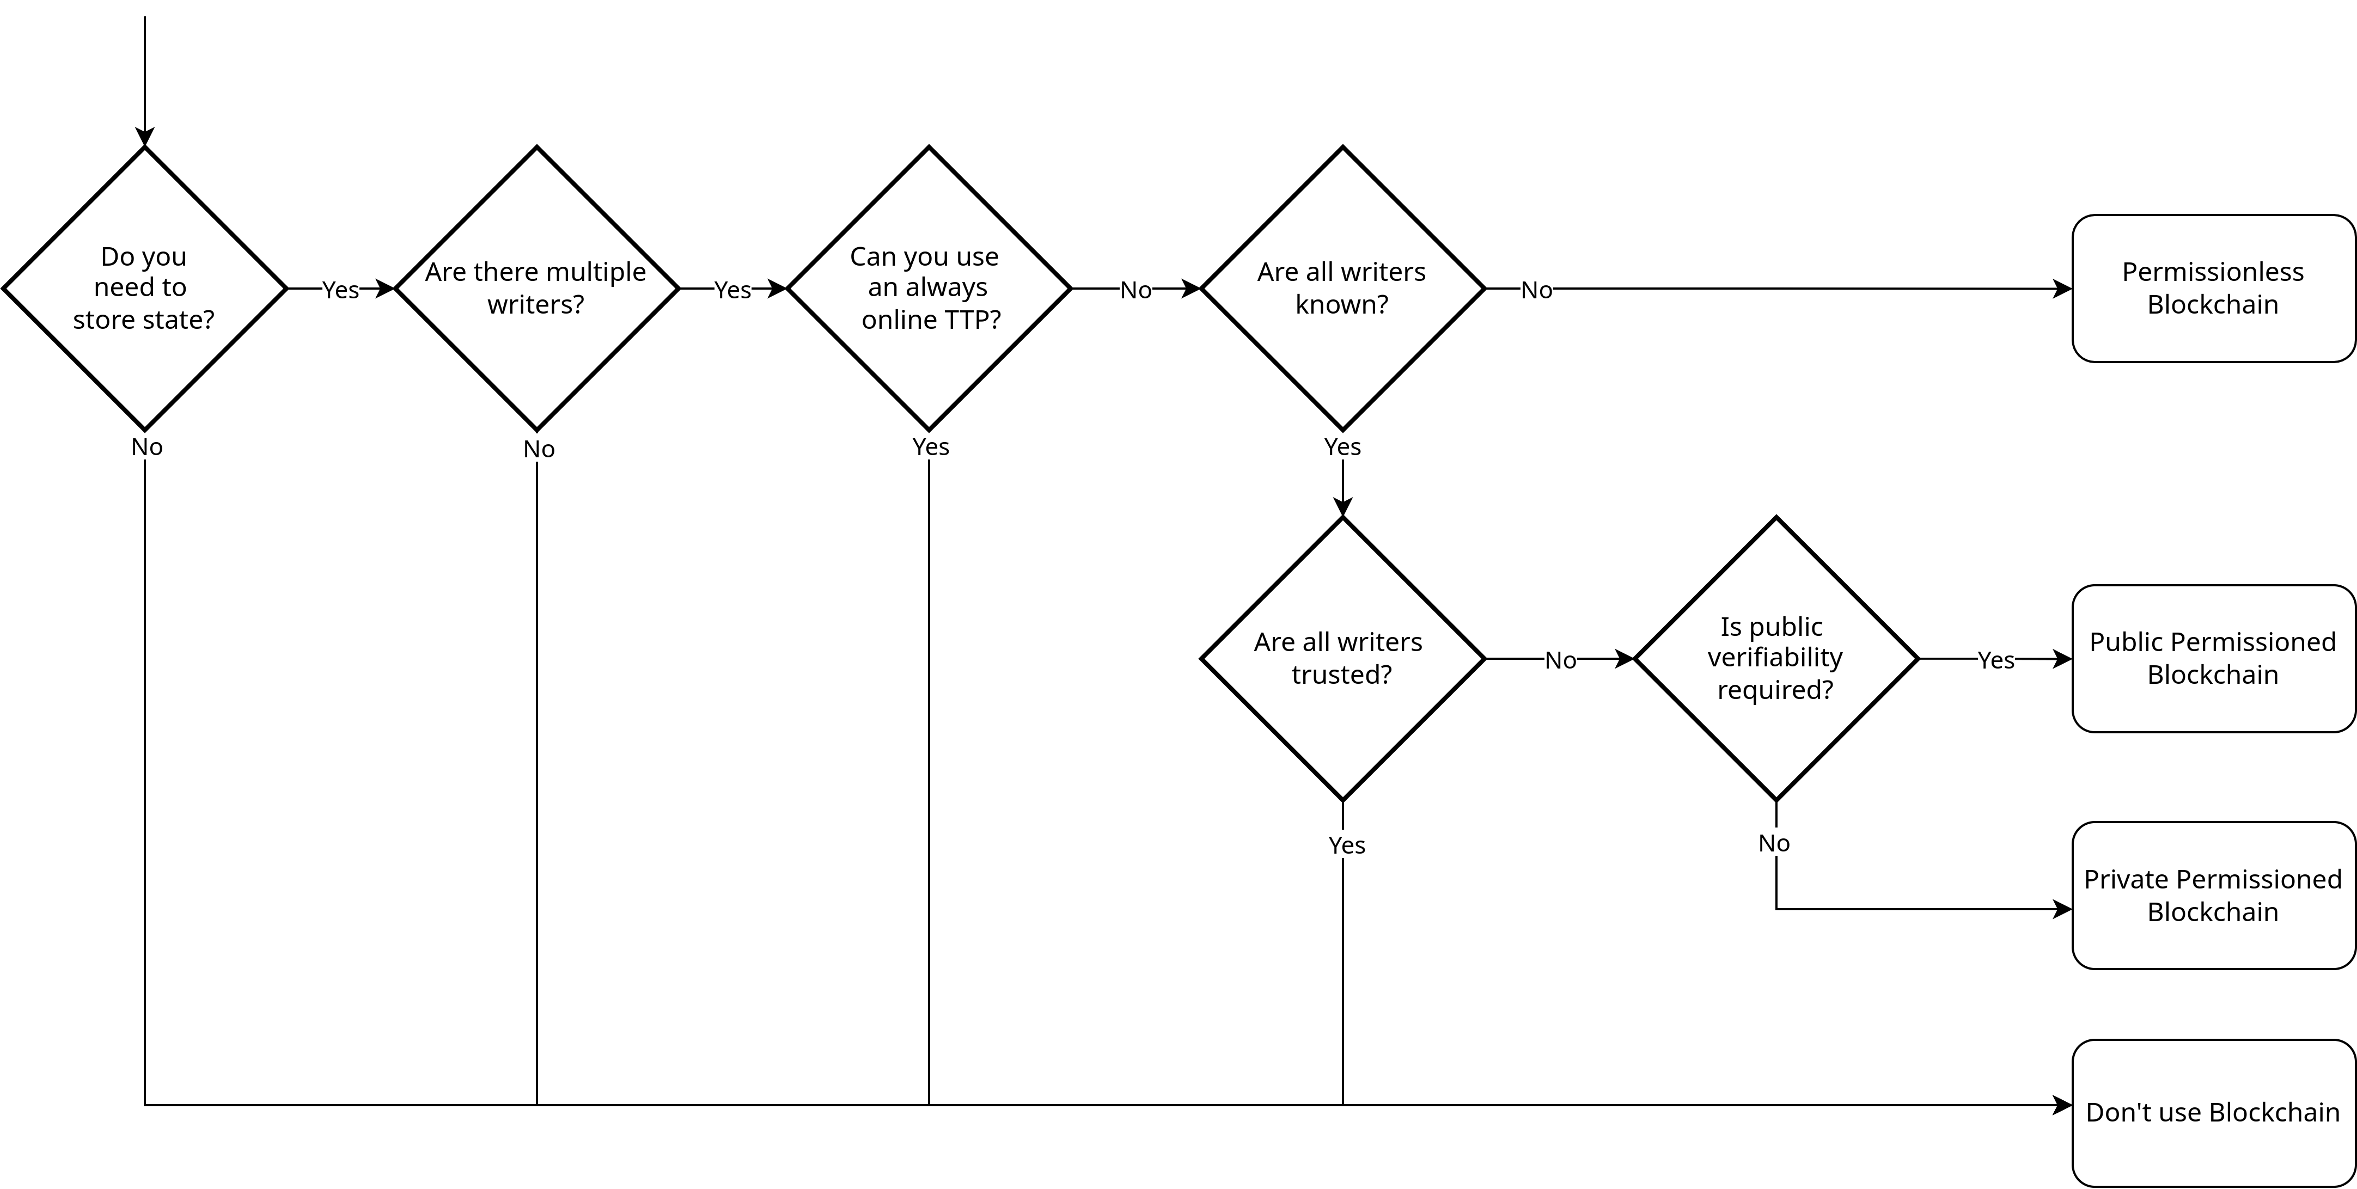
Do I need a blockchain for that?
Image recreated from K. Wüst and A. Gervais, “Do you need a Blockchain?” IACR Cryptology ePrint Archive, vol. 2017, p. 375, 2017.

Slide 32
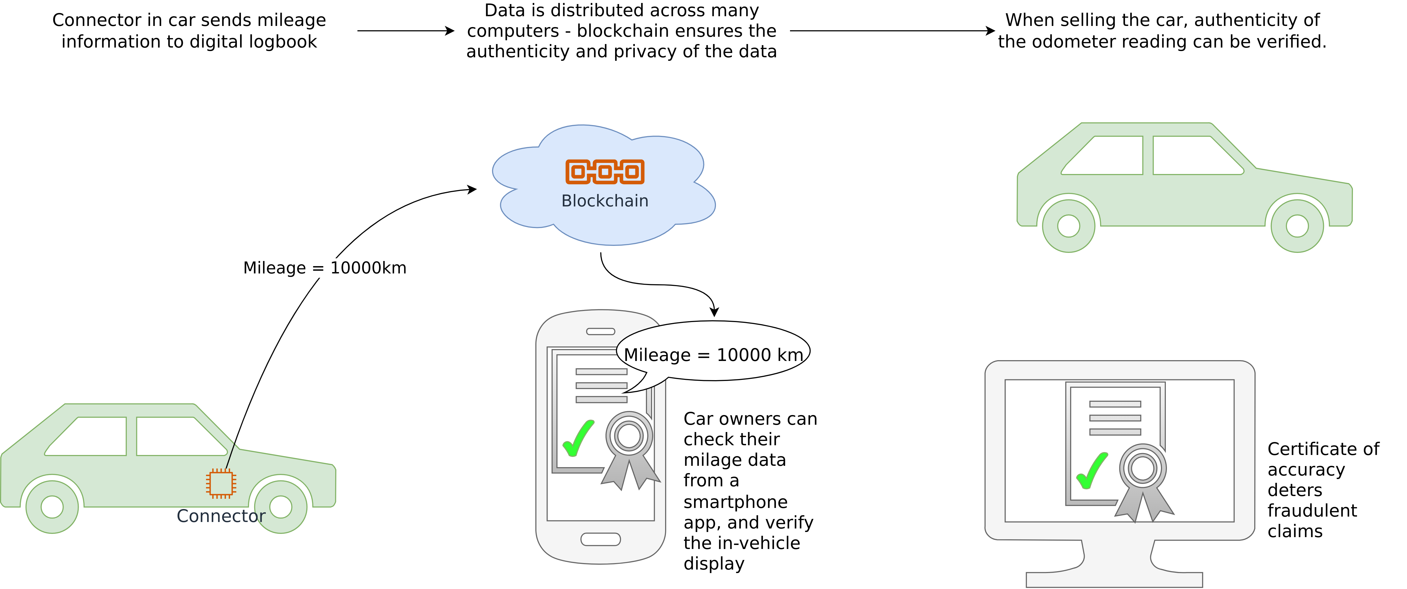
Mileage Logging
Image adapted from https://twitter.com/boschglobal/status/844131521426538497?lang=en

Slide 33
Access Management
Not only buildings
Sharing economy (cars, bikes, apartments, etc.)
Also:
Health records
Insurance information (e.g., car insurance)
⇒ Sharing of personal data in general

Slide 34

Supply-Chain Management
Pharmaceutical supply chain management

Slide 35
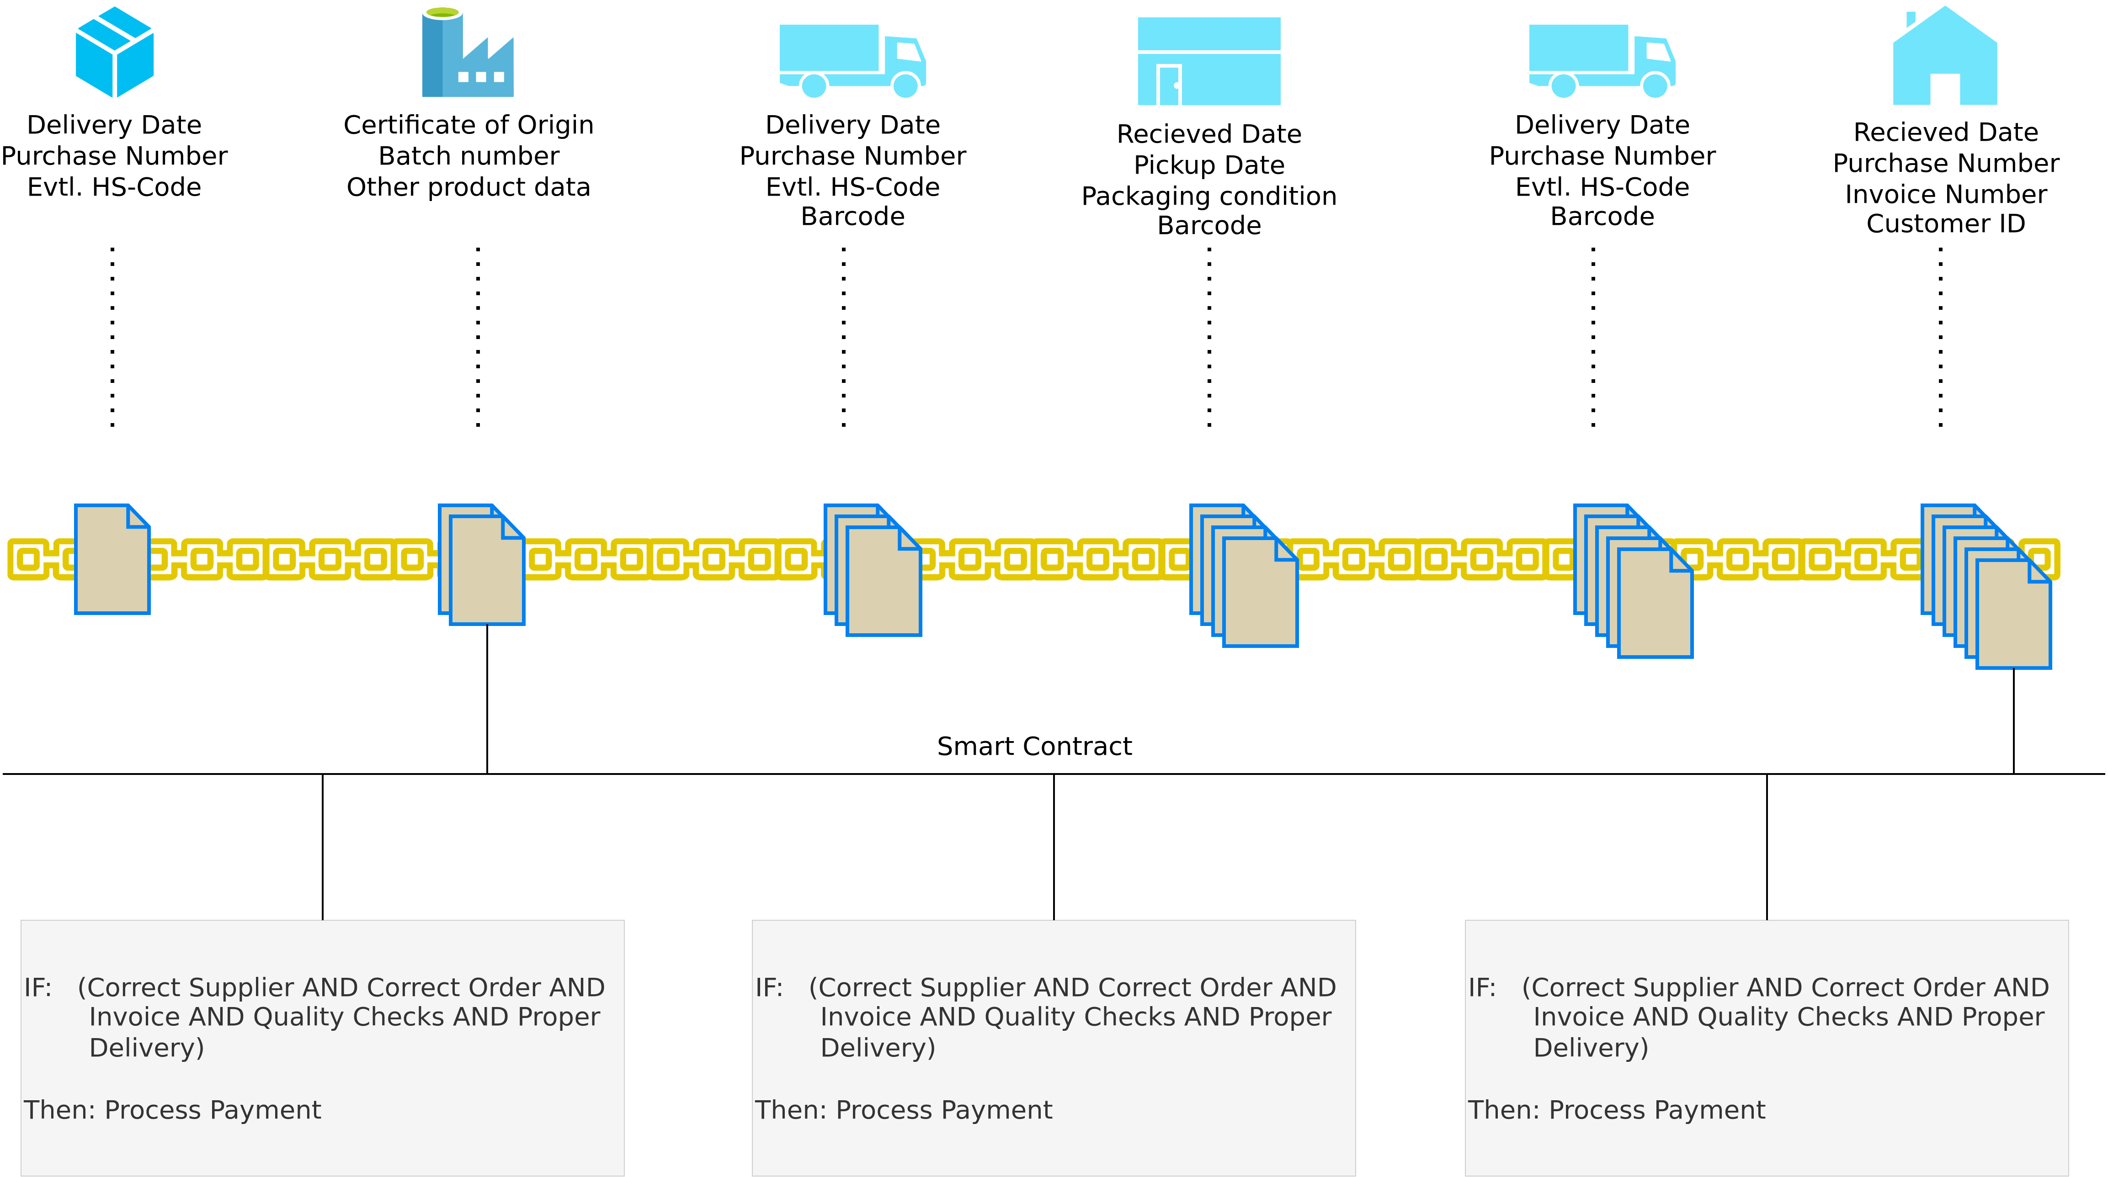
Supply-Chain Management
Image recreated from: BearingPoint – Blockchain als Treiber im modernen Supply Chain Management 4.0 (2018).

Slide 36
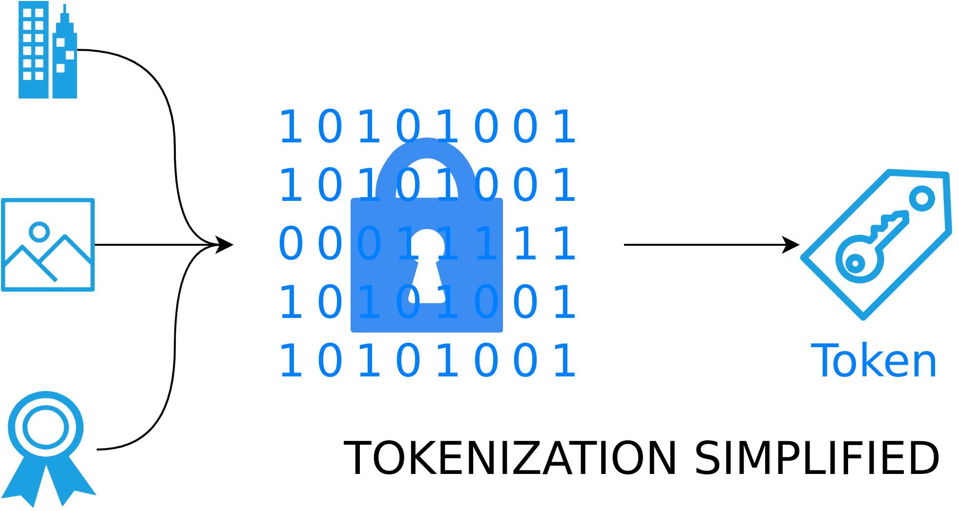
Asset Tokenization
Image recreated based on blog.softwaremill.com

Slide 37
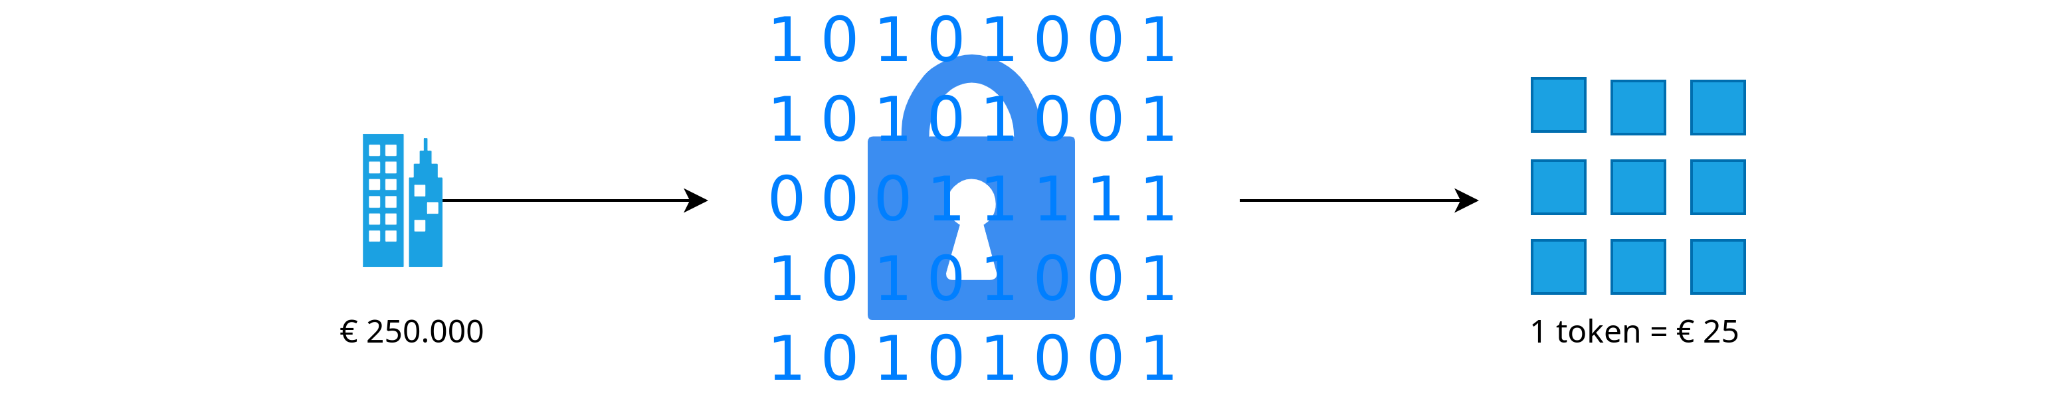
Asset Tokenization
Image recreated based on blog.softwaremill.com

Slide 38
Further Applications
Identity solutions (Self-Sovereign Identities, DIDs, Authcoin, Unchained(X), Rechained, BlockVoke)
Spotify on the blockchain
Voting
Land registry entries
Frictionless payment solutions
and so on ...

Slide 39
Cryptography for Blockchain Technology

Slide 40
Quick Note
While cryptocurrencies use cryptographic techniques such as cryptographic hash functions and signature schemes, there is usually no encryption or decryption involved.

Slide 41
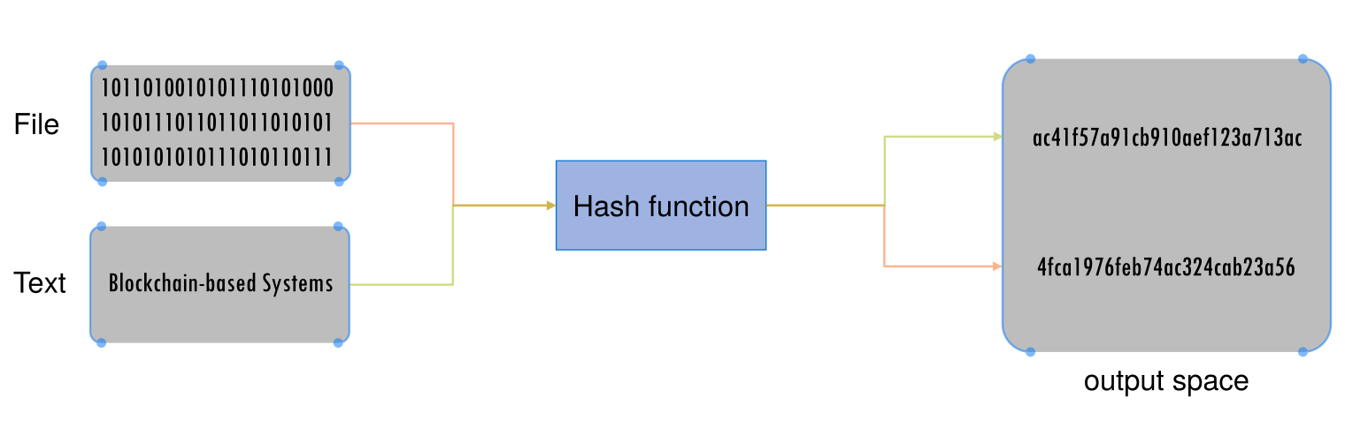
What Are Hash Functions?
Definition:
A function h is called a hash function if it has the following properties:
Compression: h maps an input x of arbitrary finite bit length to an output h(x) of fixed bit length n:
h : 0, 1∗ → 0, 1^{n}
Ease of computation: Given h and x it is easy to compute h(x)
U. Gallersdörfer, P. Holl, and F. Matthes, “Blockchain-based Systems Engineering – Lecture Slides,” Oct 2019. [Online]. Available: https://github.com/sebischair/bbse

Slide 42
Additional Properties of Cryptographic Hash Functions
Cryptographic hash functions have certain properties in addition,compared to regular hash functions.
First two definitions that will be useful for the remainder of this section. Definition If a function h is a one-way function, then a function h⁻¹ does not exist. It is therefore computationally infeasible to find the input to an output of h.
Definition A problem that is computationally infeasible is e.g. a ”hard” instance of an NP-hard problem of sufficient size. ”Hard” means that there is no more efficient way of solving the problem than trying all possible solutions (”bruteforce”). Sufficient means that the size is large enough that it can be considered not computable with classical computers, e.g. a search space of size 2²⁵⁶.

Slide 43
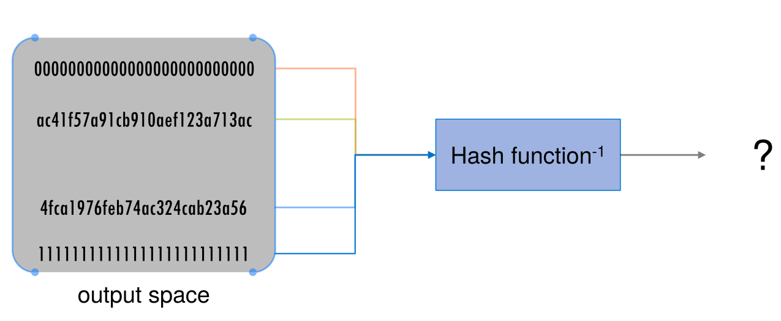
Additional Properties of Cryptographic Hash Functions
Definition Preimage resistance of hash function h:
For essentially all pre-specified outputs y, it is computationally infeasible to find an x such that h(x) = y
h is also called a one-way function
U. Gallersdörfer, P. Holl, and F. Matthes, “Blockchain-based Systems Engineering – Lecture Slides,” Oct 2019. [Online]. Available: https://github.com/sebischair/bbse

Slide 44
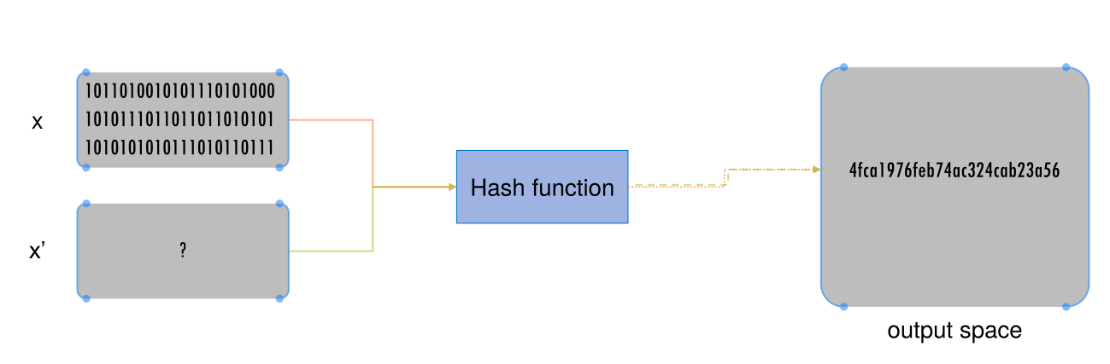
Additional Properties of Cryptographic Hash Functions
Definition
Second preimage resistance is the property of a hash function h that for a given x it is computationally infeasible to find any second input x' with x != x' such that h(x) = h(x'). In other words, it is computationally infeasible to find a different input x' that results in the same output.
U. Gallersdörfer, P. Holl, and F. Matthes, “Blockchain-based Systems Engineering – Lecture Slides,” Oct 2019. [Online]. Available: https://github.com/sebischair/bbse

Slide 45
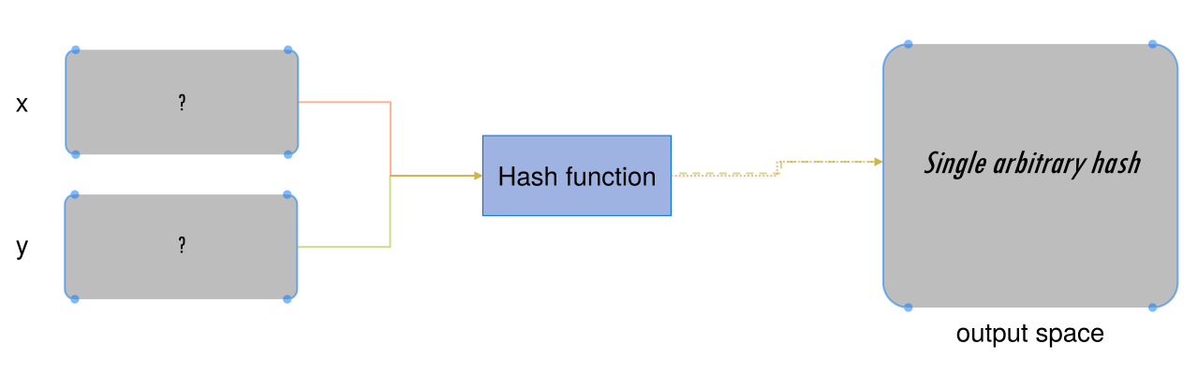
Additional Properties of Cryptographic Hash Functions
Definition
A hash function h is said to be collision resistant if it is computationally infeasible to find two values x and y such that x != y , but h(x) = h(y). In other words, it is computationally infeasible to find two values that hash to the same output. This is different from second preimage resistance insofar as here no fixed x or output is given and both inputs may be changed.
U. Gallersdörfer, P. Holl, and F. Matthes, “Blockchain-based Systems Engineering – Lecture Slides,” Oct 2019. [Online]. Available: https://github.com/sebischair/bbse

Slide 46
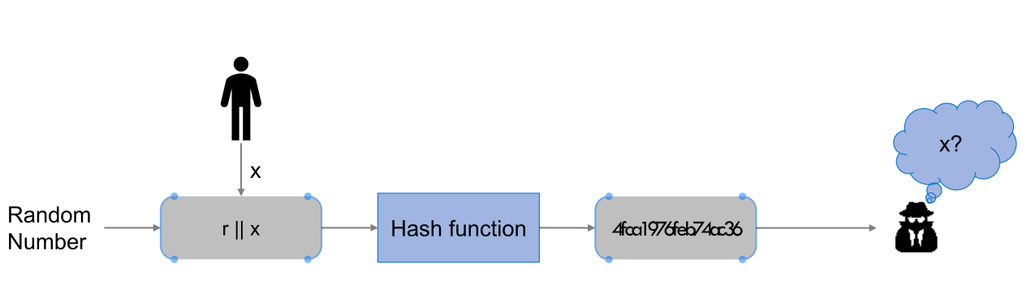
Additional Properties of Cryptographic Hash Functions
Definition
A hash function h is said to be hiding if, for a secret, randomly chosen value r of sufficient size, given h(r||x) it is computationally infeasible to find x. Sufficient size, again, refers to the search space. A size of 256 bit can usually be considered sufficient.
This means that the hash function in combination with a random number can protect the value x contained in the hash, even if is from a small set of values that otherwise could easily be found through bruteforce.
U. Gallersdörfer, P. Holl, and F. Matthes, “Blockchain-based Systems Engineering – Lecture Slides,” Oct 2019. [Online]. Available: https://github.com/sebischair/bbse

Slide 47
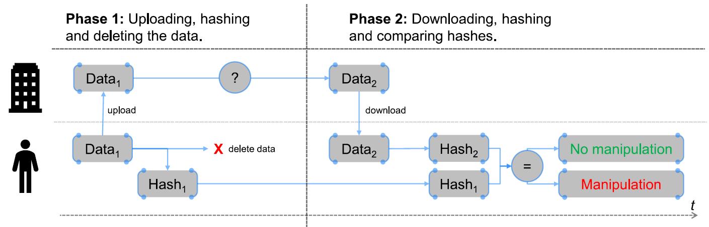
Application: Message Digests
Suppose you want to store information on an external hosting service. After a successful upload on the external service you want to free up space by deleting that information from your hard drive. You plan to download the data later. However, you want to make sure that the external party cannot modify your content in the mean time without you knowing about the manipulation. How do you proceed? As of the property second preimage resistance of the cryptographic hash function it is not possible to generate the same hash with different contents. Therefore, if the external service manipulates your data, the hash changes. With that, manipulation can be detected if you store the hash instead of the data itself.
U. Gallersdörfer, P. Holl, and F. Matthes, “Blockchain-based Systems Engineering – Lecture Slides,” Oct 2019. [Online]. Available: https://github.com/sebischair/bbse

Slide 48
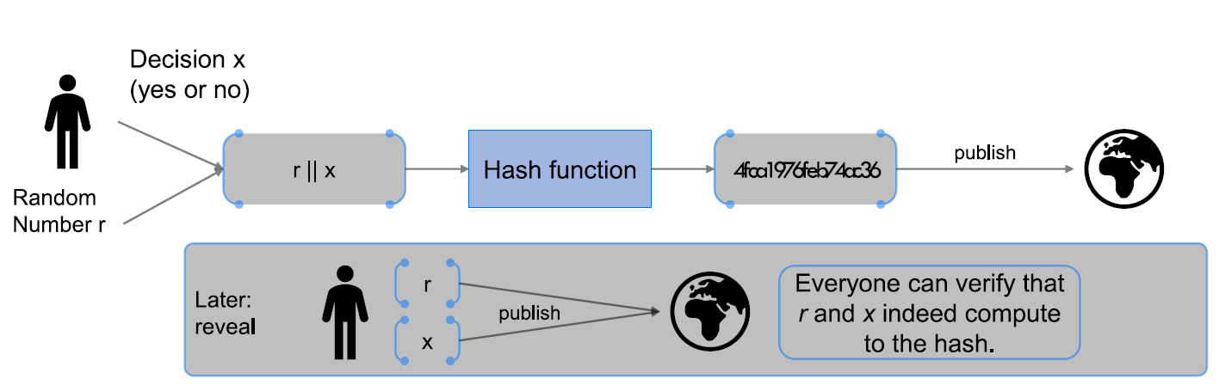
Application: Commitments
A person can commit to a value without revealing it immediately by using a hiding cryptographic hash function.
Definition
A commitment scheme consists of two algorithms:
com := commit(msg; nonce) where msg is the message and nonce is the random number. The hash of the concatenation is returned.
verification := verify(com; msg; nonce) where msg is the result of checking whether a given (msg; nonce) pair produces the same result as com.
U. Gallersdörfer, P. Holl, and F. Matthes, “Blockchain-based Systems Engineering – Lecture Slides,” Oct 2019. [Online]. Available: https://github.com/sebischair/bbse

Slide 49
Application: Search Puzzle
A search puzzle is a mathematical problem which requires searching a very large space in order to find a solution. In particular, there are no shortcuts in finding the solution. h has an n bit output, therefore it can take any of 2^{n} values. Solving the puzzle requires finding an input so that the output falls within the set Y. Depending on the size of the set Y, the puzzle can be more or less difficult, e.g., if the set contains all n bit strings it is trivial, if it contains only one string, it is maximally hard. Definition
A search puzzle consists of:
Cryptographic hash function h, used to compute the puzzle results
A value id, a puzzle-ID used to make the puzzle unique
A target set Y, which contains all valid solutions
Computation: id is concatenated with a value x and hashed. x changes until the puzzle result is in Y.

Slide 50
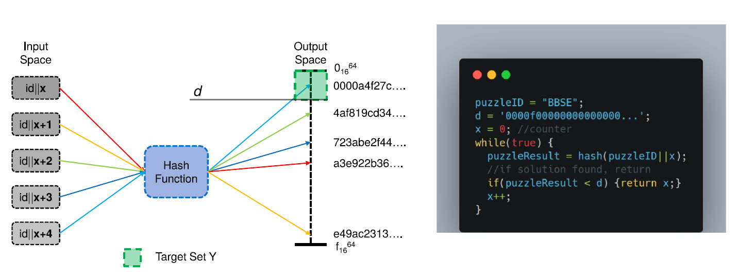
Application: Search Puzzle Visualized
While For simplicity we define the target set Y as 0, 1, …, d, therefore we only have to check if the result of the hash function is smaller than the difficulty d. For our example, we use a puzzle-ID of "BSSE", but in practice it must not be known in advance as otherwise solutions can be recomputed The puzzle-ID needs to be different for each instance of the puzzle.
U. Gallersdörfer, P. Holl, and F. Matthes, “Blockchain-based Systems Engineering – Lecture Slides,” Oct 2019. [Online]. Available: https://github.com/sebischair/bbse

Slide 51
Cryptographic Hash Functions – SHA Family
There are many different cryptographic hash algorithms:
Message Digest 4 / 5 (MD4 / MD5) Considered broken!
Secure Hash Algorithm 1 (SHA-1) Considered broken!
Secure Hash Algorithm 2 / 3 (SHA-2 / SHA-3) At the moment safe to use, favor SHA-3 over SHA-2.
The most important rule in cryptography: Never do your own crypto!
Use established libraries! (libsodium is pretty nice)
The SHA family
The SHA family describes a group of hash functions standardized by the National Institute for Standards and Technology (NIST). The SHA-1 and SHA-2 algorithms were developed by the NIST and the National
Security Agency (NSA). After the rst attacks on SHA-1 in 2004, the NIST started a competition to nd a new, more secure algorithm to become SHA-3. In 2012, Keccak was announced as the SHA-3 standard.
Keccak itself is not a single hash algorithm, but a family of hash algorithms with different parameters.

Slide 52
Data Structures
Hashes can be used to build different data structures. In the following, a few of them will be introduced.

Slide 53
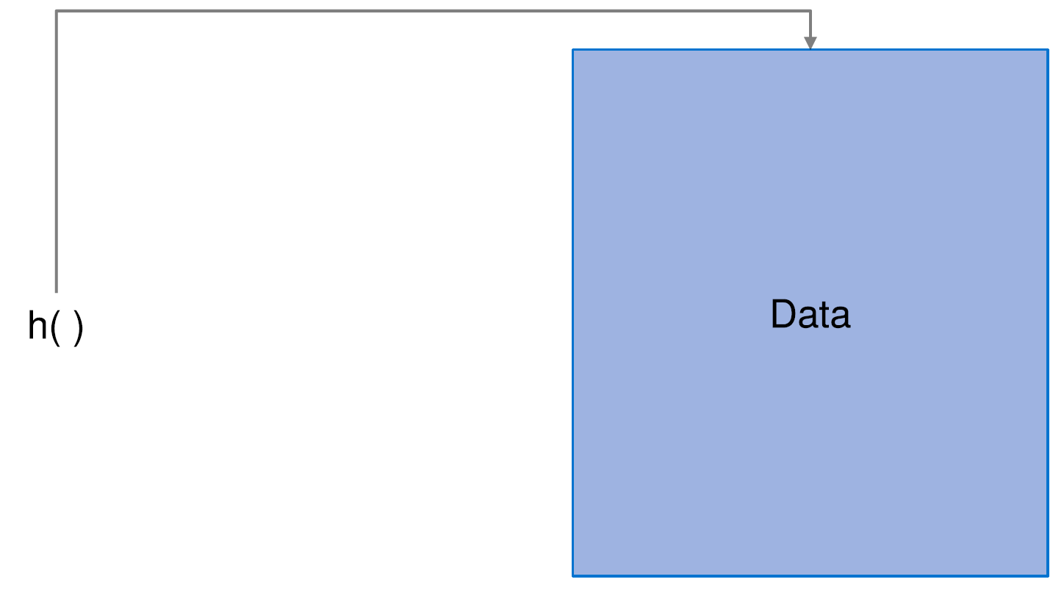
Hash Pointers
A hash pointer contains information about the location of data enriched with a cryptographic hash of it. The difference between a regular pointer and a hash pointer is, that a hash pointer allows verifying that the data has not changed.

Slide 54
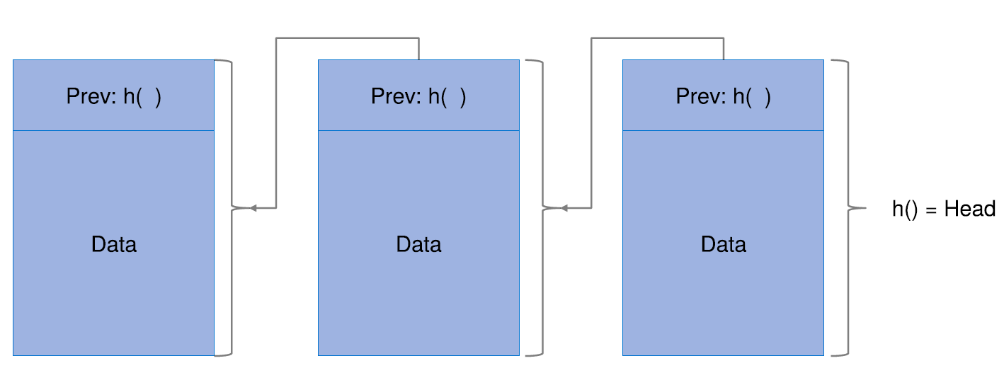
Blockchain
Here a linked list of hash pointers is shown. This is typically referred to as a blockchain. Instead of normal pointers, hash pointers are used. With this, the integrity of the complete blockchain can be ensured. If the information in any block is manipulated, the block's hash will change and no longer match the hash given in the block pointing to it. This means that just knowing the hash of the head of the blockchain is enough to verify the integrity of the entire chain.

Slide 55
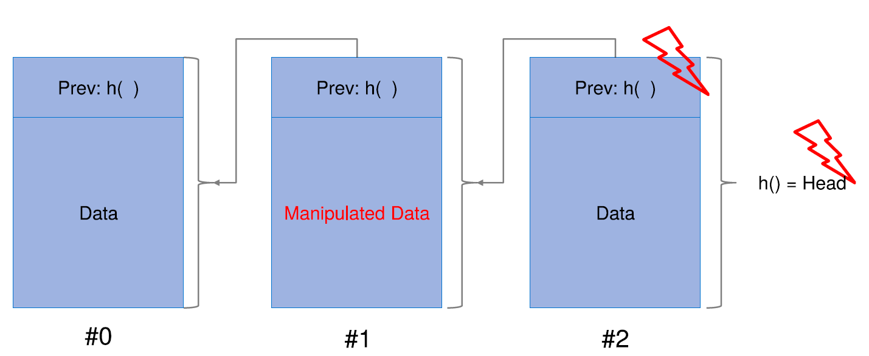
Blockchain (cont.)
Here is an example of how a manipulation of block #1's data would be detected:

Slide 56
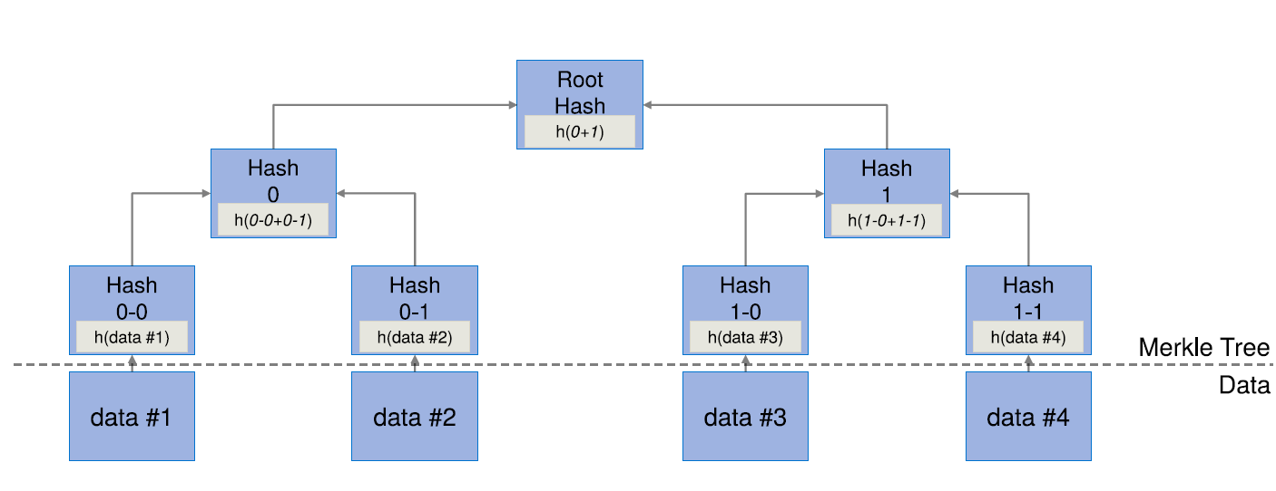
Merkle Trees
Merkle trees (sometimes referred to as hash trees) are a data structure using cryptographic hashes. They are used as an efficient and secure way to verify the integrity of large datastructures and provide short (O(log N)) proofs that certain nodes are indeed part of the tree (proof of membership).
In the case of sorted Merkle Trees, it can also be proven that certain nodes are not part of the Merkle tree (proof of non-membership).

Slide 57
Merkle Trees – Proof of Membership
The proof of membership is what is most commonly used in blockchain applications. The problem solved by this is as follows:
We want to verify that a certain block of data is contained in the Merkle tree without hashing or even having all the data belonging to the tree. One scenario where this is useful is so-called Simple Payment
Verification (SPV) clients in the Bitcoin network. These clients only download block headers and know the hashes of the Merkle tree roots of each block. Using a proof of membership, these, often resource
constrained, light clients can validate the existence of a transaction on the blockchain.
We can do this by only verifying the hashes of nodes along the path from the node to be verified up to the root. This can be done win O(log N) time.

Slide 58
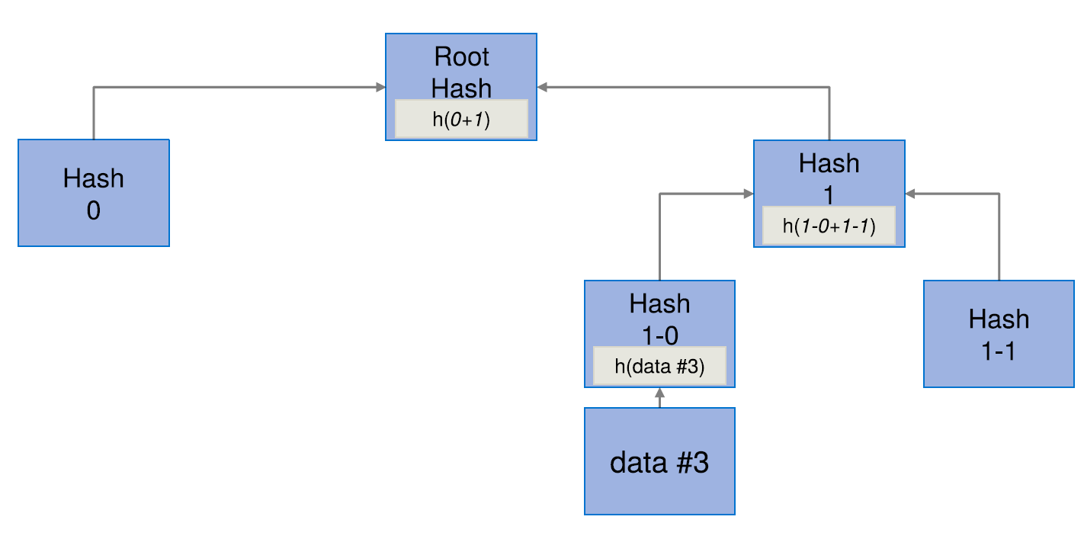
Merkle Trees – Proof of Membership (Example)
In this example, we can see how for a Merkle tree with four leaf nodes, the presence of node #3 can be verified using the hashes 0 and 1-1.

Slide 59
Bloom Filters
Bloom Filters do not have any direct relationship to cryptography or blockchains, but they can be useful for the implementation of blockchain related software. They allow heuristic checks on whether an element is in a given set S. Given a possible element e, the bloom filter will return one of two values:
false or 0: The element e is definitely not in the set.
true or 1: The element e might be in the set.
Due to the possibility of false positives, bloom filters cannot be used in every scenario.
Bloom filters can be implemented similar to hash tables. Rather than storing the elements however, it suffices to store a single bit per element. All bits are initialized as 0. For each element in S, the bit at
the corresponding position in the hash table will be set to 1.
To query the bloom filter, the bit at the location of the given element's hash is returned. As multiple elements may hash to the same value false positives may occur, but false positives are impossible.

Slide 60
Digital Signatures – Overview
Digital signatures are based on asymmetric cryptographic algorithms such as RSA or ECC. There are two properties that need to hold for digital signatures. First, only the entity holding the private key is able to create a signature, but everyone can verify it. Secondly, the signature is tied to a certain piece of data which gets signed. It cannot be used as a signature for different data.
Definition
A digital signature scheme consists of three algorithms:
(sk; pk) := generateKeys(keysize) where sk is the secret key used to sign messages and pk is the public key distributed to everyone and used to verify the signature.
sig := sign(sk; message) where sk is the secret key and message the message to be signed and sig is the output signature for the given message.
isValid := verify(pk; message; sig) where pk is the public key corresponding to the secret key sk that signed the message. If sig is indeed a signature generated using sk for the message message, isValid is true, otherwise it is false.
In addition, the following conditions must hold:
verify(pk; message; sign(sk; message)) == true
Signatures are unforgeable

Slide 61
Unforgeability
Definition
Signatures are called unforgeable if under the following conditions, an attacker still cannot create a valid signature for any unseen message:
The attacker knows the corresponding public key pk
The attacker sees signatures sig signed for pk for an arbitrary amount of messages

Slide 62
Digital Signatures – Algorithms
Two major digital signature schemes are available:
RSA based schemes such as RSA-PSS were invented in 1997 by Rivest, Shamir and Adleman and are based on the assumption that the factorization of large prime numbers after multiplication is very hard, but easy with additional information (so called trapdoor one-way functions)
ECC based schemes such as ECDSA were suggested independently by Neal Koblitz and Victor S. Miller in 1985 and are based on discrete logarithms. Another variant called EdDSA with favorable properties for secure implementations and based on Edwards curves was proposed by Daniel J. Bernstein et al. in 2012¹.
Key sizes of at least 2048 bit for RSA and at least 256 bit for ECDSA are recommended.
Due to higher performance and smaller key sizes in ECC compared to RSA, Bitcoin uses ECDSA.
1: D. J. Bernstein, N. Duif, T. Lange, P. Schwabe, and B. Yang, "High-speed high-security signatures," J. Cryptographic Engineering, vol. 2, no. 2, pp. 77{89, 2012. [Online]. Available: https://doi.org/10.1007/s13389-012-0027-1

Slide 63
Digital Signatures – Practical Concerns
Many signature algorithms are based on entropy. Without a strong source of entropy, private keys may be leaked.
Digital signatures can only sign a small amount of data. However, as long as a secure cryptographic hash function is used, signing the hash of the message is sufficient.
Private keys are not recoverable. If they are lost, it becomes impossible to act as the entity represented by the key. This may result in lost money, assets, etc.
An appropriate key length should be used. If the key length is too short, the private key might get computed in the future.

Slide 64
Digital Signatures For Identity Creation
Digital signature schemes can be used as identity systems where the public key acts as an identity and the private key is the "password" used to act on behalf of this identity.
New identities can be generated at will using the generateKeys function and are at first not connected to any real-world identity and therefore pseudonymous, although acting under the identity may intentionally or unintentionally leak information about its connection to the real-world identity behind it.
Hashing public keys of identity may provide certain benefits, such as reducing their size and reducing their exposure to possible quantum computing attacks.
To validate a statement for a hashed public key, the public key has to be attached to the statement. The verifier can then validate that the public key hashes to that of the identity and that the message signature verifies with respect to the provided public key.

Slide 65
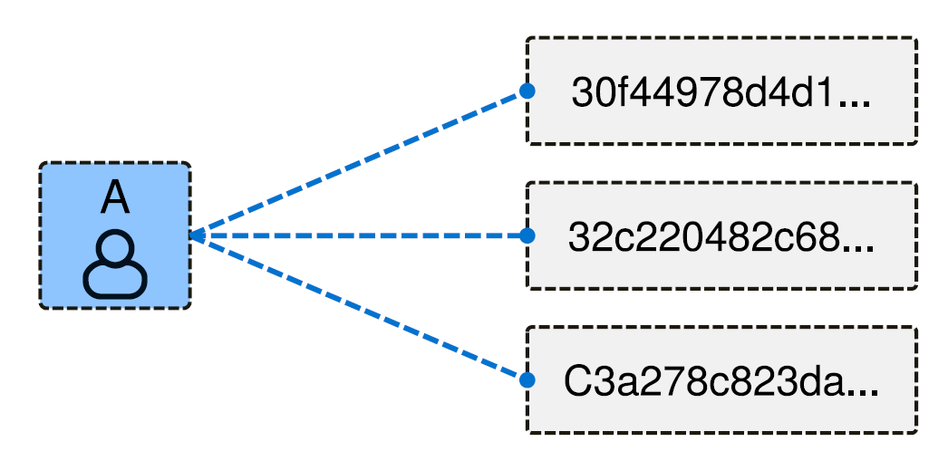
Decentralized Identity Management
This approach allows a decentralized identity management without a need for registering identities at a central authority, allowing each user to create an arbitrary amount of identities while being simple to verify
All cryptocurrencies / blockchain based systems handle it this way
The address is (in Bitcoin and Ethereum) the hash of a public key
U. Gallersdörfer, P. Holl, and F. Matthes, “Blockchain-based Systems Engineering – Lecture Slides,” Oct 2019. [Online]. Available: https://github.com/sebischair/bbse

Slide 66
Digression: Quantum Resistance of Signature Schemes and Hash Functions
Digital signature schemes based on the integer factorization problem, the discrete logarithm problem or the elliptic curve discrete logarithm problem can be solved with Shor's algorithm on sufficiently powerful quantum computers¹.
Cryptographic hash functions are considered to be relatively secure against quantum computers², but hash based signature schemes suffer from slow speeds and big signature sizes.
What are the implications?
Can decentralized identity management work in a post-quantum World?
Can Bitcoins be stolen using quantum computers?
How can we prevent this?
1: D. J. Bernstein, "Cost analysis of hash collisions: Will quantum computers make SHARCS obsolete," SHARCS, vol. 9, p. 105, 2009. [Online]. Available: https://cr.yp.to/hash/collisioncost-20090517.pdf 2: P. W. Shor, "Polynomial-Time Algorithms for Prime Factorization and Discrete Logarithms on a Quantum Computer," SIAM J. Comput., vol. 26, no. 5, p. 1484{1509, Oct. 1997. [Online]. Available: https://doi.org/10.1137/S0097539795293172

Slide 67
Can decentralized identity management work in a post-quantum world?
The fact that Bitcoin addresses are hashed public keys gives them some degree of resistance against quantum computer attacks.
Hashing itself is not broken by quantum computers
As long as only the hashed public key of a bitcoin address is known, it is computationally infeasible to calculate the private key and nothing can be stolen
As long as quantum computers take longer to break a public key than it takes for a bitcoin transaction to be confirmed, the system remains usable, as long as public keys are never reused
In today's Bitcoin, address reuse is considered bad hygiene. In a post-quantum world, it will get your funds stolen.

Slide 68
Further Resources
Bitcoin Whitepaper – Link
Ethereum Whitepaper – Link
Blockchain für Entwickler – Grundlagen, Programmierung, Anwendung – Link
Architecture for Blockchain Applications – Link
The Path to Self-Sovereign Identity – Link
A Review on Consensus Algorithm of Blockchain – Link
Blockchain Consensus Protocols in the Wild – Link
Ethereum for Developers – Link
Blockchain-based Systems Engineering – TU Munich – Link

Slide 69
Exercise E07

Slide 70

Exercise E07
Evaluating the MOOC Content
As we have explained in the beginning of the lecture, we are currently working on developing asynchronous and interactive learning content for the “Limits to Growth” lecture.

Slide 71
Exercise E07
Evaluating the MOOC Content
As we have explained in the beginning of the lecture, we are currently working on developing asynchronous and interactive learning content for the “Limits to Growth” lecture.
Work through the whole lesson on “Sustainable Everyday Practices and Foodsharing”
Go to the website (Link).
Read all the texts, watch the videos and answers the assessment questions.
2. After you completed the online lesson, please answer the following questions:
What did you like about the MOOC content?
Which parts of the MOOC content did you not like?
Give up to three ways this online learning material could been improved.

Slide 72
Questions?

